Slide 1


An Overview of Bias and Fairness in Algorithmic Models
David M. Kent, MD, MSc
Professor of Medicine, Neurology, Clinical and Translational Science,
Director, Predictive Analytics and Comparative Effectiveness (PACE) Center,
Institute for Clinical Research and Health Policy Studies, Tufts Medical Center

Slide 2
A Selective Overview
Part I: Fairness and the impossibility results
Part II: Label Bias: are you predicting the ideal target or a proxy?
Part III: Unfairness versus Bias: is the prediction polar or non-polar?
Part IV: Should “race” be included in clinical prediction models?

Slide 3
Part I: Fairness and the impossibility results
Part II: Label Bias: are you predicting the ideal target or a proxy?
Part III: Unfairness versus Bias: is the prediction polar or non-polar?
Part IV: Should “race” be included in clinical prediction models?

Slide 4

Capuchin Monkey Video
Part I: Fairness and the impossibility results

Slide 5
Fairness
Part I: Fairness and the impossibility results
Sense of fairness is profound and phylogenetically old.
There is nothing wrong with cucumbers until your neighbor gets grapes.
A decent society cares about unfairness and tries to mitigate unfairness.
Perceptions of fairness are inherently asymmetric and biased.
Can there be an objective measure of fairness?

Slide 6
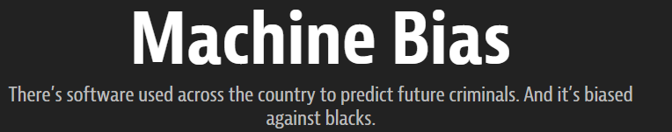
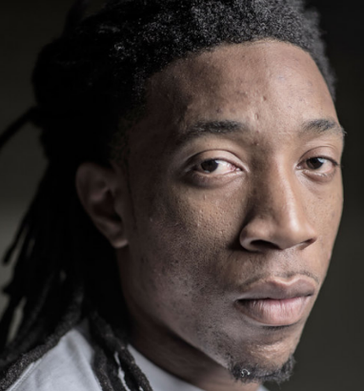

Propublica
Part I: Fairness and the impossibility results
https://www.propublica.org/article/machine-bias-risk-assessments-in-criminal-sentencing

Slide 7
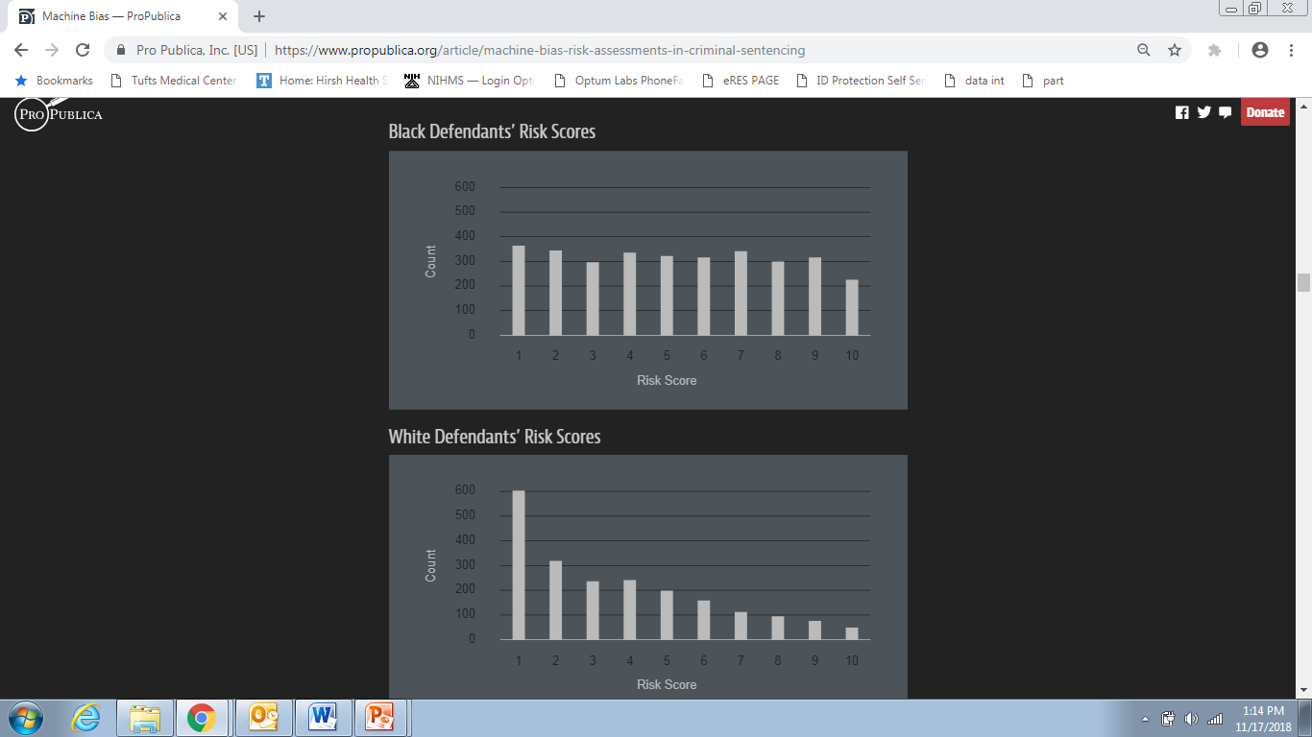
Propublica: Risk Distributions from COMPAS
Part I: Fairness and the impossibility results
Low Risk Score
High Risk Score

Slide 8
Part I: Fairness and the impossibility results
Black defendants are at higher predicted risk on average.
Even black defendants that do not re-offend are at higher average predicted risk than white defendants who do not re-offend.
Violates fairness criteria of “equalized odds”

Slide 9
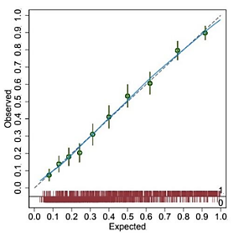
COMPAS
Part I: Fairness and the impossibility results
Model is well calibrated:
  Well calibrated overall and separately in both black defendants and white defendants.

Slide 10
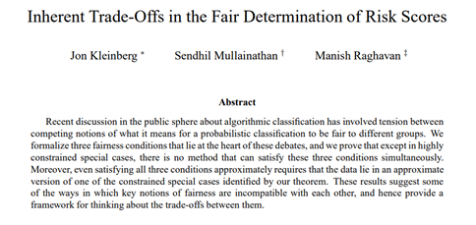
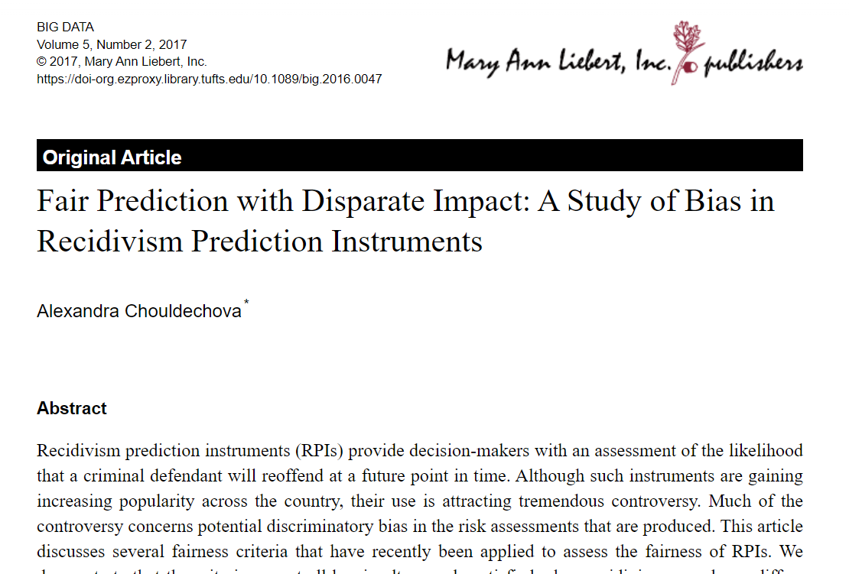
Impossibility Theorem
Part I: Fairness and the impossibility results
arXiv:1609.05807v2; Big Data 2017. 5, 153–163.

Slide 11
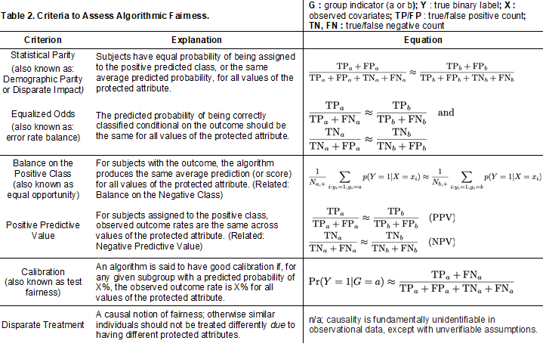
Explosion of Fairness Metrics
Part I: Fairness and the impossibility results
NPJ Digit Med. 2020 Jul 30;3:99.

Slide 12
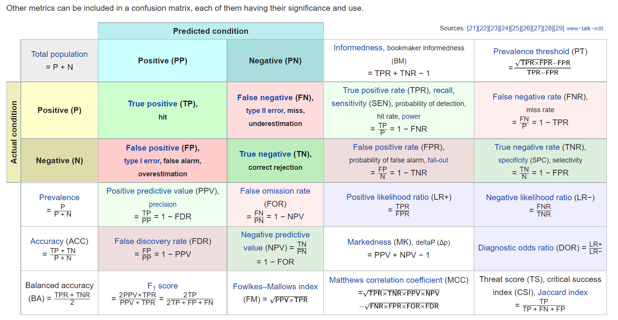
Confusion Matrix /Contingency Table
Part I: Fairness and the impossibility results

Slide 13
Interim Summary
Part I: Fairness and the impossibility results
There is no universally accepted operational definition of fairness.
Definitions of fairness are mutually conflicting.
Even in the absence of model invalidity (“e.g. god’s model”), all threshold dependent definitions are “prevalence sensitive”—they will differ between subgroups with different prevalences.
“God’s model” will always be well calibrated.
The Journal of Machine Learning Research 2024 Mar;24(1):1532-4435

Slide 14
Part I: Fairness and the impossibility results
Part II: Label Bias: are you predicting the ideal target or a proxy?
Part III: Unfairness versus Bias: is the prediction polar or non-polar?
Part IV: Should “race” be included in clinical prediction models?

Slide 15
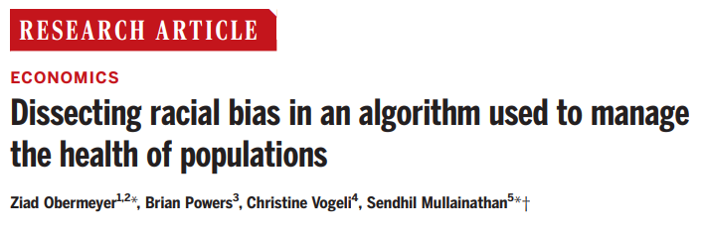
Label Bias: when bias is “baked into the data”
Arrest versus re-offend
Medical examples:
  Medical need versus medical cost
  Diagnosis versus disease (e.g. cancer diagnosis)
  Medical futility

Slide 16
Label Bias
Part II: Label Bias: are you predicting the ideal target or a proxy?
When there is a difference in outcome risk, ask whether the disparity is likely to be the result of label bias.

Slide 17
Part I: Fairness and the impossibility results
Part II: Label Bias: are you predicting the ideal target or a proxy?
Part III: Unfairness versus Bias: is the prediction polar or non-polar?
Part IV: Should “race” be included in clinical prediction models?

Slide 18
Unfairness versus Bias

Slide 19
Sometimes fairness / distributive justice is irrelevant to clinical prediction
Part III: Unfairness versus Bias: is the prediction polar or non-polar?
Non-medical examples of polar prediction (subject has an interest in a higher or lower score, not an accurate score)
  Recidivism
  Predictive policing
  Risk of loan default
  Insurance premiums

Slide 20
Examples of Non-polar prediction
Part III: Unfairness versus Bias: is the prediction polar or non-polar?
Should I take a statin or an aspirin to prevent a heart attack?
  What is my 10 year risk of a heart attack?
Should I decide to get a prostate cancer biopsy?
  What is my risk of aggressive prostate cancer?
Shared decision making context.

Slide 21

Non-polar Predictive Contexts
Part III: Unfairness versus Bias: is the prediction polar or non-polar?
Non-polar predictions refer to those where interests of subject and decision maker are aligned
  Typically, shared priority is the most accurate prediction
  Wish to maximize benefit and avoid harm for the individual patient
Harm
Point of indifference
Benefit
low
high
Predicted probability of an outcome

Slide 22

Part III: Unfairness versus Bias: is the prediction polar or non-polar?
Polar Predictive Contexts
Those where the decision maker’s interest in efficient decision making is not aligned with the subject’s interest to have a lower or higher prediction

Slide 23
Part III: Unfairness versus Bias: is the prediction polar or non-polar?
Positively polar predictions
- Micro-allocation (e.g. organ transplantation)
- Care management programs (e.g. Diabetes Prevention Program)
Patient interest in selection
(+)
low
high
Predicted probability of an outcome
Negatively polar predictions
- Screening for child abuse risk
- Involuntary commitment
Patient interest in avoidance
(-)
low
high
Predicted probability of an outcome

Slide 24
Summary Slide
Part III: Unfairness versus Bias: is the prediction polar or non-polar?
Algorithmic bias refers to issues related to the accuracy of predictions, especially those that may disproportionately affect model performance in a certain subgroup.
In contrast, issues of fairness arise when the interest of one individual or group come into conflict with another.
Fairness issues arise specifically in polar decision contexts.

Slide 25
Part I: Fairness and the impossibility results
Part II: Label Bias: are you predicting the ideal target or a proxy?
Part III: Unfairness versus Bias: is the prediction polar or non-polar?
Part IV: Should “race” be included in clinical prediction models?

Slide 26
Can clinical prediction models better address health care disparities when they are 'race-aware'?

Slide 27
COVID Treatments
Monoclonal antibodies, Paxlovid, Remdesevir
Part IV: Should “race” be included in clinical prediction models?
Minnesota Department of Health: BIPOC status was worth 2 points, the same as diabetes or age greater than 65
New York: nonwhite status would counts as risk factor
Utah: gives non‐​white race or Hispanic/​Latinx identity two points, more than hypertension or chronic pulmonary disease

Slide 28
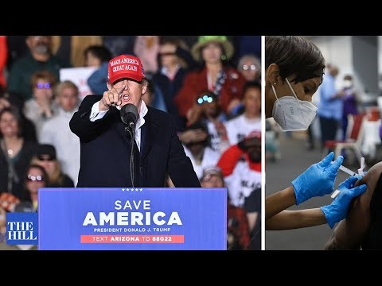
COVID example:
Part IV: Should “race” be included in clinical prediction models?

Slide 29
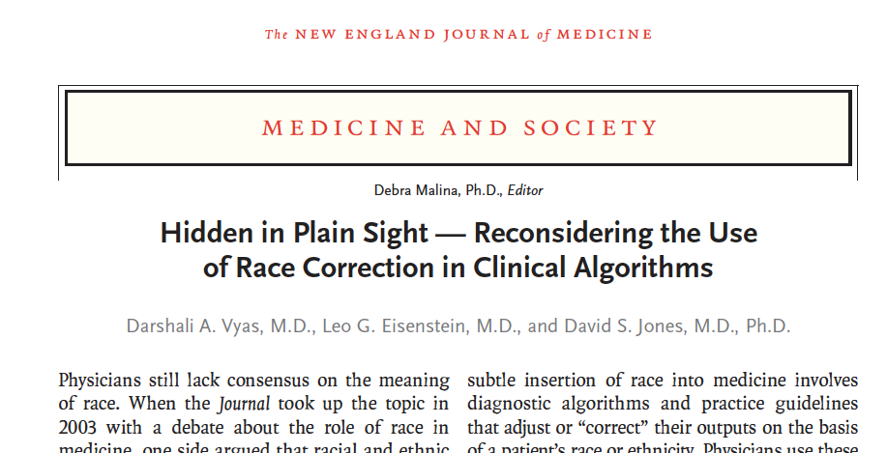
Part IV: Should “race” be included in clinical prediction models?
NEJM 383;9. August 27, 2020

Slide 30
Part IV: Should “race” be included in clinical prediction models?
“Physicians use these algorithms to individualize risk assessment and guide clinical decisions. By embedding race into the basic data and decisions of health care, these algorithms propagate race-based medicine.
Many of these race-adjusted algorithms guide decisions in ways that may direct more attention or resources to white patients than to members of racial and ethnic minorities.”
NEJM 383;9. August 27, 2020

Slide 31
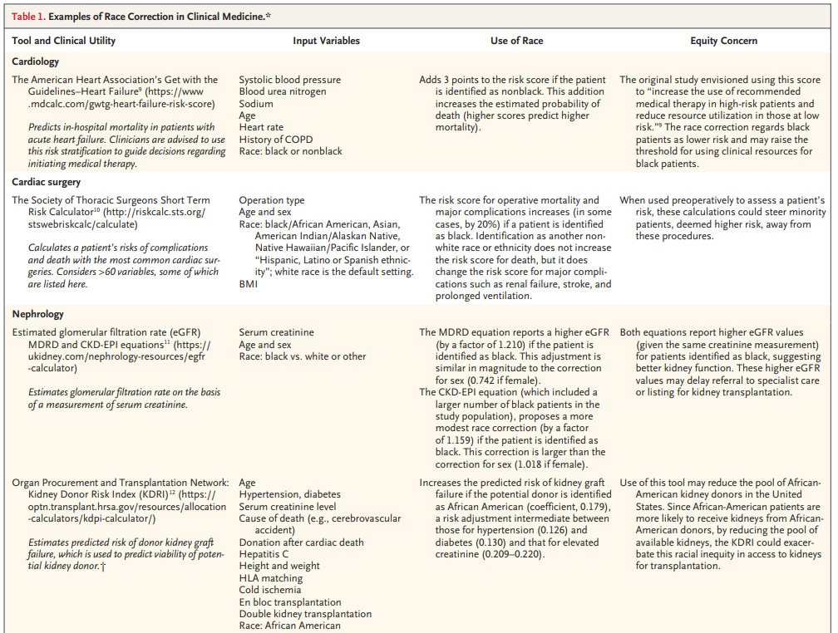
“When used preoperatively to assess a patient’s risk, these calculations could steer minority patients, deemed higher risk, away from these procedures”

Slide 32
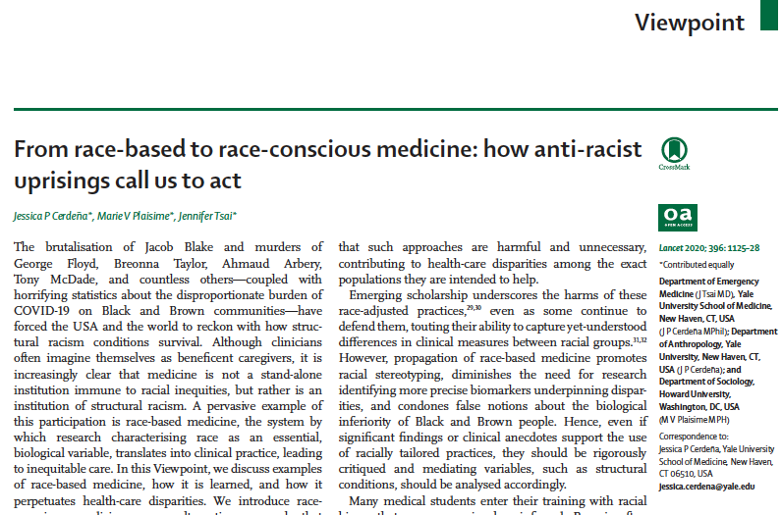
Part IV: Should “race” be included in clinical prediction models?
Lancet 2020; 396: 1125–28

Slide 33
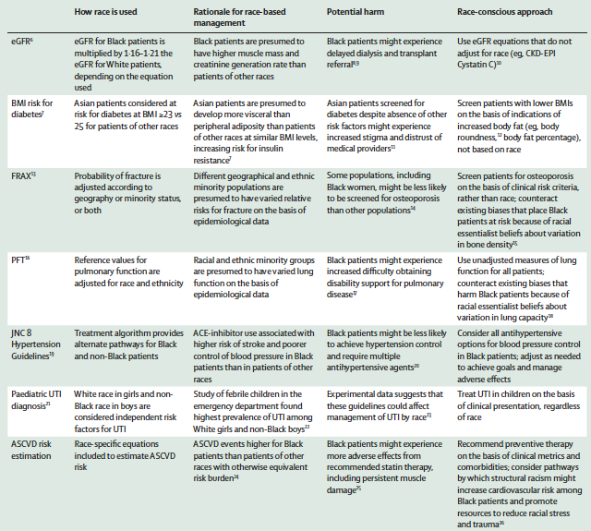
“Black patients might experience more adverse effects from recommended statin therapy, including persistent muscle damage”

Slide 34
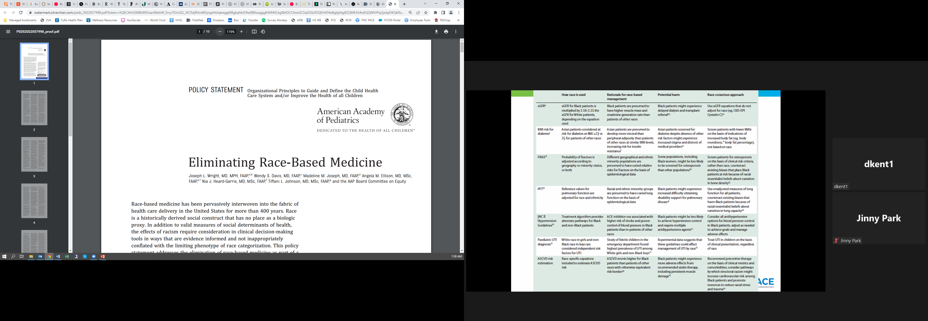
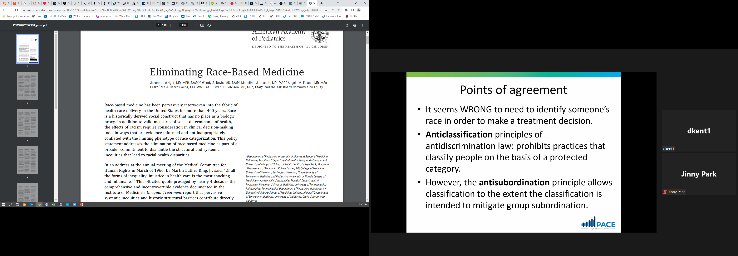
Part IV: Should “race” be included in clinical prediction models?
In 2020, the AAP Annual Leadership Forum passed a resolution, “Prohibit the Use of Race-Based Medicine,” through which “the Academy shall end the practice of using race as a proxy for biology or genetics in all their education events and literature, and…require [that] race be explicitly characterized as a social construct when describing risk factors for disease with all presentations at AAP-sponsored conferences.”
Pediatrics. 2022 Jul 1;150(1):e2022057998.

Slide 35


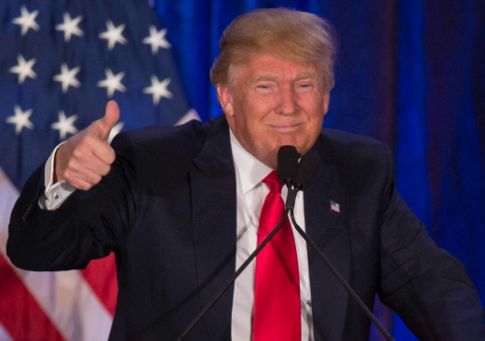


What controversy?
Part IV: Should “race” be included in clinical prediction models?

Slide 36
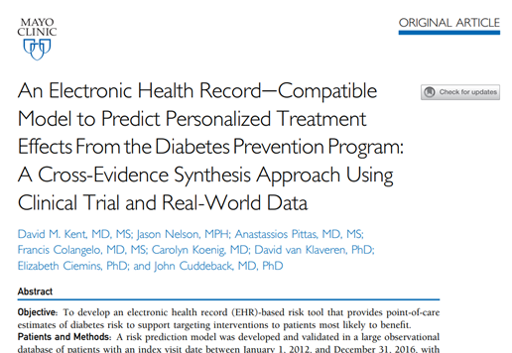
Predicting Diabetes Risk
Part IV: Should “race” be included in clinical prediction models?
At the same time, we were developing a diabetes risk prediction model to be used for the prioritization of prediabetic patients for the DPP program.
This model explicitly encoded race.
In this presentation, we describe
our reasoning.
Mayo Clin Proc 2022 Apr;97(4):703-715

Slide 37
Point of agreement
Part IV: Should “race” be included in clinical prediction models?
It seems WRONG to need to identify someone’s race in order to make a treatment decision.
Anticlassification principles of antidiscrimination law: prohibits practices that classify people on the basis of a forbidden category.
In contrast, the antisubordination principle allows classification to the extent the classification is intended to challenge group subordination.

Slide 38
Key points/ Premises
Part IV: Should “race” be included in clinical prediction models?
Race is a social construct that is not a direct cause of health outcomes—except via the health effects of racism.
Yet it is correlated with a combination of interacting factors related to SES, culture, genetic ancestry and the health effects of racism;
It is sometimes importantly predictive of health outcomes—especially where disparities in outcomes exist.
It is important not to conflate prediction with causal inference

Slide 39
Key points/ Premises (continued)
Part IV: Should “race” be included in clinical prediction models?
Patients with similar relevant clinical characteristics should be treated similarly regardless of race;
Patients at similar outcome risk should be treated similarly regardless of race;
  Equal treatment for equal risk
When race has no prognostic information independent of relevant clinical characteristics, there is no controversy or dilemma.

Slide 40
Key points/ Premises (continued)
Part IV: Should “race” be included in clinical prediction models?
Controversy arises only when patients of different racial identities have different outcome risks despite similar clinical characteristics—a condition that defines disparities.

Slide 41
Diabetes Prevention Program (DPP) Randomized Controlled Trial
Part IV: Should “race” be included in clinical prediction models?
Participants: 3060 non-diabetic persons with evidence of impaired glucose metabolism
Intervention: Intervention groups received metformin or a lifestyle-modification program
Main Outcome Measure: Development of diabetes
  The DPP study was conducted by the DPP Investigators and supported by the National Institute of Diabetes and Digestive and Kidney Diseases (NIDDK).

Slide 42
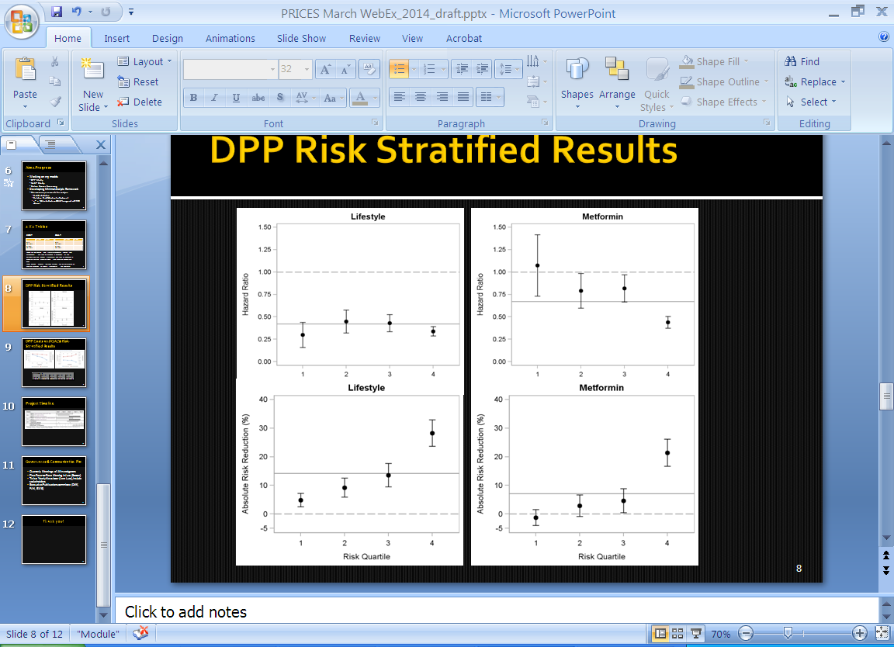
DPP Risk-Stratified Results: Absolute Risk Reduction
Twice the average benefit
Three times the
average benefit
No benefit
All four quartiles achieve some benefit from
the DPP intensive lifestyle intervention
BMJ. 2015 Feb 19;350:h454

Slide 43
Redevelop DPP Risk Model using Typical EHR Data: OLDW
Model developed and geographically validated in OptumLabs
Risk factors: age, gender, race, ethnicity, height, BMI, smoking status, hypertension, A1c, FPG, triglycerides, HDL, SBP
Mayo Clin Proc. 2022 Apr;97(4):703-715.
43

Slide 44
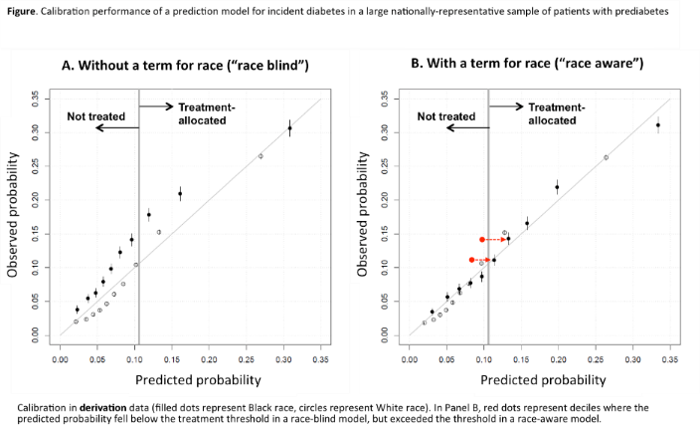
Race-blind vs. Race-aware models for diabetes risk among patients with pre-diabetes:
Black patients have ~30% higher risk
Filled dots represent Black race, circles represent White race
Red dots represent deciles where the predicted probability fell below the treatment threshold in a race-blind model, but exceeded the threshold in a race-aware model.
Mayo Clin Proc. 2022 Apr;97(4):703-715.
Notes:
KN: This is ok to use for a population level prediction, but not for the individual level
For results like this, we should use the model without race and then let patients know that they are in a higher risk group. There is no need to add modifiers to their score
JS: how do we categorize other races or mixed race participants?
DK: we are stuck with the variables that are in the database that we have. For this model race was categorized as “white, black, Asian, other (mixed race and other)”

Slide 45
Race-blind vs. Race-aware models for diabetes risk among patients with pre-diabetes:
Black patients have ~30% higher risk
Filled dots represent Black race, circles represent White race
Red dots represent deciles where the predicted probability fell below the treatment threshold in a race-blind model, but exceeded the threshold in a race-aware model.
Mayo Clin Proc. 2022 Apr;97(4):703-715.
Notes:
KN: This is ok to use for a population level prediction, but not for the individual level
For results like this, we should use the model without race and then let patients know that they are in a higher risk group. There is no need to add modifiers to their score
JS: how do we categorize other races or mixed race participants?
DK: we are stuck with the variables that are in the database that we have. For this model race was categorized as “white, black, Asian, other (mixed race and other)”

Slide 46
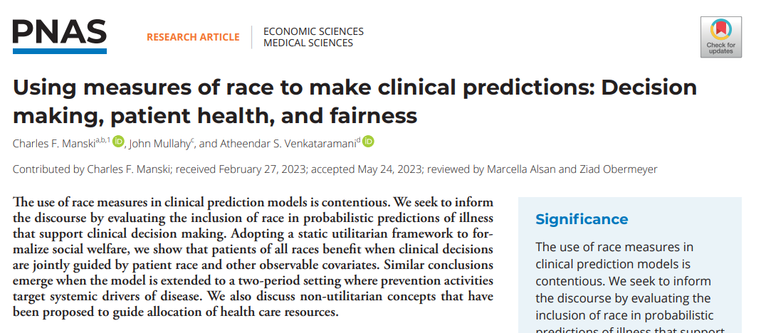
Note: including race accomplishes 2 things
Improves targeting to the “high risk” group (disparity-reducing”)
Makes predictions more accurate for all (corrects subgroup invalidity, important for non polar conditions)
  In absence of label bias, “race aware” model is at least as accurate as the most accurate “race unaware” model
Proc Natl Acad Sci U S A . 2023 Aug 9;120(35):e2303370120.

Slide 47
Principle: Equal treatment for equal risk
Risk-based medicine is not race-based medicine
Conforms to a fairness principle and leads to the most efficient distribution of scarce resources.
Black patients who were COVID infected were at ~2-fold the risk of hospitalization, even after controlling for other factors.

Slide 48
What do we know about the extra risk in Black patients?
It is real (i.e. not due to label bias) and measurable.
It is large.
It has causes (even if these causes are difficult to measure or not always precisely known), and those causes are disproportionately experienced by Black people.

Slide 49
Leaving race out of risk calculations does not treat Black and white people equally — it systematically ignores those (unknown or unmeasured) causes of greater Covid or DM risk that are more common in Black people than white people.
For decision making, the risk associated with these unmeasured causes is no less important than the risk associated with known and measured characteristics.

Slide 50
Not an unusual case
By targeting screening or therapies to patients based on risk (or by prioritizing patients at high risk), risk-based approaches focus resources where they are most needed.
The field of disparities research has documented that Black patients often have worse outcomes, and higher risks, than otherwise similar white patients, even after controlling for clinical characteristics.
In such circumstances, leaving race out of CPMs may ignore and exacerbate disparities.

Slide 51
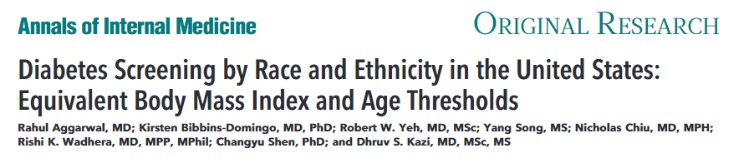
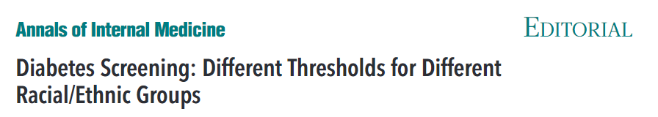
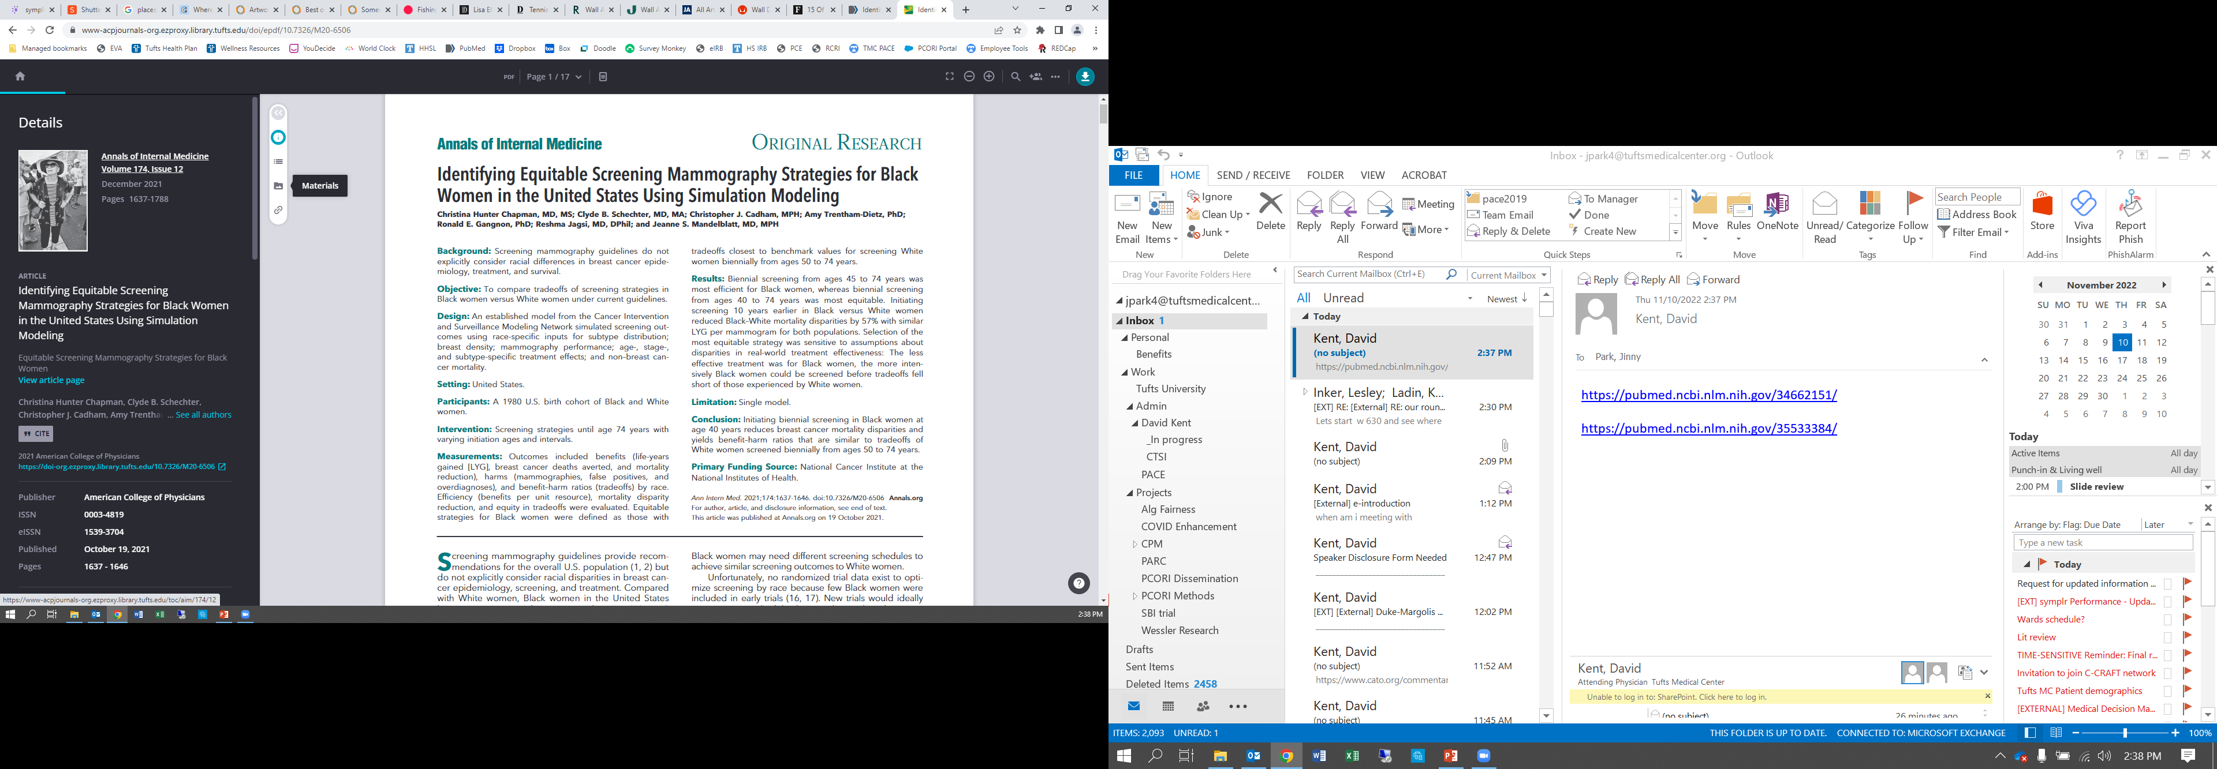
Other examples of
“Equal treatment for equal risk”
COVID
Diabetes Screening
ASCVD Risk
Colon Cancer (screening at age 45 vs 50)
Breast Cancer (screening at age 40/45 vs 50)
Lung Cancer
Prostate Cancer Risk calculation for Bx
Risk-based medicine is [often] a disparities reducing algorithm.
Ann Intern Med. 2022 Jun;175(6):765-773.
Quyen Ngo-Metzger
Ann Intern Med. 2022 Jun;175(6):895-896.
Ann Intern Med. 2021 Dec;174(12):1637-1646.

Slide 52
To be sure
There are always good reasons to leave race out of Clinical Prediction Models
  Anti-classification principles.
  Long, sordid history of racial essentialism in medicine
  Potentially undermines trust with patients
  Can exacerbates “Label bias”
Sometimes anti-classification principles align with other important goals of reducing bias (i.e. improving accuracy) and unfairness (minimizing disparities).
Sometimes they don’t.

Slide 53
Potential Justification of Race Aware versus Race Unaware
Polar decisional context: Disparity reduction
Non-polar decisional context: reducing subgroup invalidity
Recognize the trade-offs:
  Specifics will matter: often added value of including race may not be large
  Values will matter

Slide 54
Technical Expert Panel
O. Kenrik Duru, MD, MS
  Professor, David Geffen School of Medicine, UCLA
John Cuddeback, MD, PhD
  Chief Medical Informatics Officer, American Medical Group Association (AMGA)
Sharad Goel, PhD, MS
  Professor of Public Policy, Harvard Kennedy School
William Harvey, MD, MSc
  Chief Medical Informatics Officer, Tufts Medical Center
  Clinical Director of Rheumatology, Tufts Medical Center
  Associate Professor, Tufts University School of Medicine
Keren Ladin, PhD (chair TEP 3-5)
  Associate Professor, Occupational Therapy, Tufts University
  Assistant Professor, Public Health and Community Medicine, Tufts University
Keith Norris, MD, PhD
  Executive Vice Chair, Department of Medicine for Equity, Diversity, and Inclusion, UCLA
  Professor of Medicine, UCLA Division of General Internal Medicine and Health Services Research
Jessica Paulus, ScD (chair TEP 1-2)
  Senior Director of Epidemiology, Om1, Inc.
  Assistant Professor of Medicine, Tufts University
Joyce Sackey, MD
  Associate Provost, Tufts University
  Chief Diversity Officer, Tufts University
Richard Sharp, PhD, MA
  Director, Biomedical Ethics Research Program, Mayo Clinic
  Director, Center for Individualized Medicine Bioethics, Mayo Clinic
Kayte Spector-Bagdady, JD, MBE
  Chair, Research Ethics Committee, University of Michigan
  Chief, Research Ethics Service, University of Michigan
Ewout Steyerberg, PhD
  Professor, Leiden University Medical Center and Erasmus MC
  Chair, Department of Biomedical Data Sciences, Leiden University
Berk Ustun, PhD, MS
  Google AI Assistant Professor, Halıcıoğlu Data Science Institute, University of California, San Diego
Saul Weingart, MD, PhD, MPP
  President, Rhode Island Hospital
  Former Chief Medical Officer, Tufts Medical Center

Slide 55
Thank you!

Slide 56
Both Vyas et al and Cedena et al
Framed the debate as between those who believed that race captures important elements of population genetics and are therefore clinically informative, and those who believe race is a social construct and therefore uninformative.
Incorrect causal assumptions lead to inaccurate models.
Consistently drives resources to white patients.
Make claims about CPM ‘bias’ without reference to the agreement between observed and predicted outcomes.

Slide 57
Summer of 2020
Massive public protests followed the police killing of George Floyd.
Several high profile articles appeared in major medical journals that were largely critical of the inclusion of race in clinical prediction models.
Many high profile institutions moved away from reporting two different eGFRs

